Slide 1
Conformity Assessment for Building Safety Enforcement in Smart Cities
U.S.-India SCCP, Phase II
July 10, 2019

Slide 2
Model Building Codes and Conformity Assessment
Some of the core infrastructure elements of the Smart Cities Mission Objectives include:
Sanitation
Housing
Sustainable Environment
Safety and Security
Good Governance with Citizen Participation
Along with model building codes, good conformity practices can help governments
meet their infrastructure goals

Slide 3
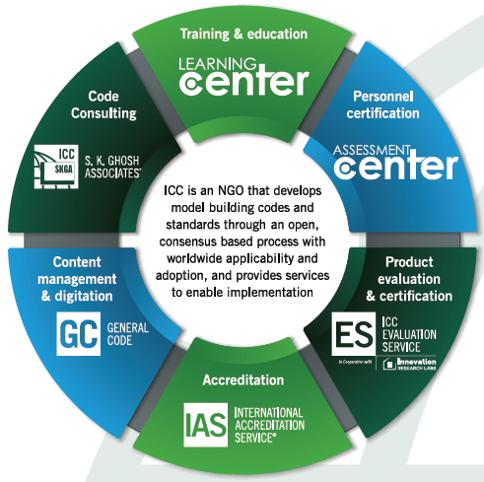
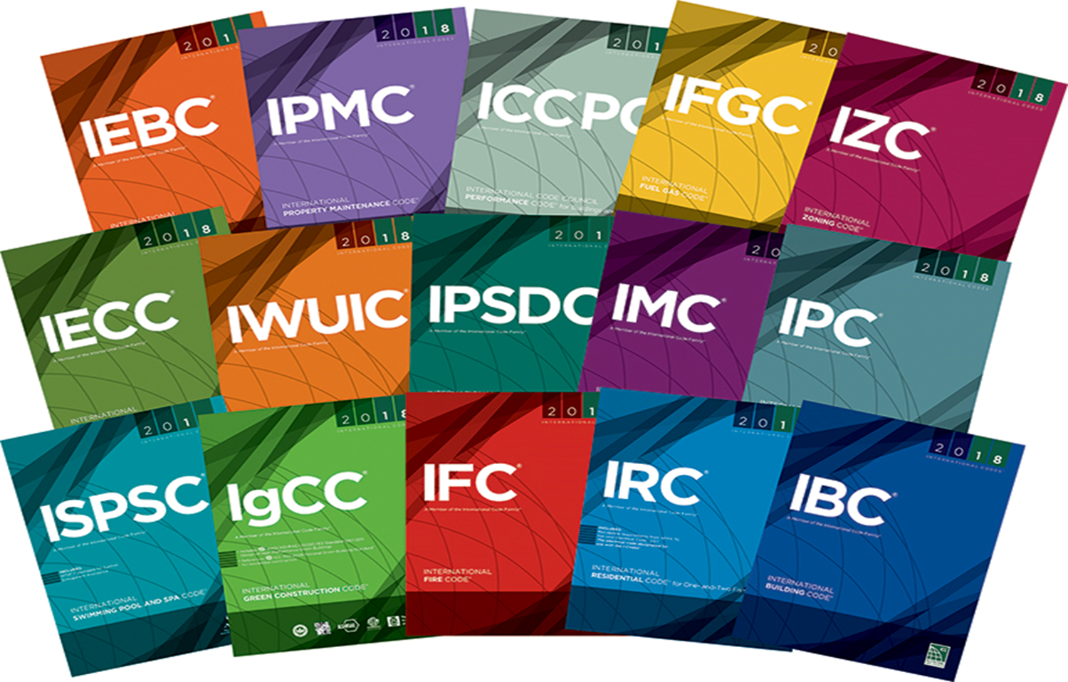
The International Code Council:
Facilitating Building Safety
Membership association that developed from the unique system in the U.S.
Develop & publish model building codes used globally
Provide products and services to help jurisdictions with building code implementation

Slide 4
Effective Building Code Enforcement is a Prerequisite for Smarter Cities
Technology helps governments serve its citizens responsively and consistently; however…
Technology can only be as smart as the operations model it supports
Building Codes & Standards help ensure
Better Sanitation
Safer Structures
Higher Energy Conservation
Resiliency and Faster Disaster Recovery

Slide 5
Enforcement, Conformity Assessment
and Smarter Cities
Good Conformity Assessment Practices, including Product Certification and Accreditation support effective enforcement of building codes and standards by providing regulators with:
Independent confirmation that building products are safe and compliant with codes and standards
Independent assurance of an organization’s competence to perform certain activities
Unique solutions to particular regulatory concerns
Lists of accredited organizations to assist regulators in the approval process
Lists of certified products for easy referral by architects, engineers, and code officials

Slide 6
Enforcement, Conformity Assessment
and Smarter Cities
Good Conformity Assessment Practices, when properly legislated, can offer an expedited avenue and tremendous support to building safety enforcement agencies without adding upfront cost to those agencies
Government regulatory agencies mandate conformity assessment requirements for products and services provided within the building safety infrastructure
Product and service providers will be required to obtain the mandatory third party approvals for their products and services
Code officials have the responsibility to verify that the product or service is certified by an accredited conformity assessment body

Slide 7
International Accreditation Service:
A Subsidiary of the International Code Council
Providing the highest quality accreditation services for all concerned with public safety and sustainability through the principle of “One Test, One Inspection, One Certification Worldwide.”
Staffed by in-house technical, management and administrative personnel with support from field-based assessors & technical experts
18 discreet & specialized accreditation programs offered globally
Customers in 40+ countries
1000+ accreditations issued to customers worldwide
Founding member of ILAC (APAC) and recognized by IAF
Notes:
Accreditation programs include Product Certification Bodies (ISO/IEC 17065), Testing Laboratories (ISO/IEC 17025), Special Inspection Agencies, Building Departments, Fire & Life Safety Departments, as well as tailored inspection schemes to ensure product quality.
ILAC (International Laboratory Accreditation Cooperation) and IAF (International Accreditation Forum)

Slide 8
How Accreditation of Conformity Assessment Practices Can Lead to Smarter Cities
Accreditation can be a resource to enhance building, code enforcement, and fire prevention practices by verifying that departments
Operate under an effective quality management system to ensure continuous improvement in operations and customer satisfaction year after year
Establish and meet quality goals to enhance the customer experience and benefit stakeholders in the community
Create safer communities because work is performed by competent staff and monitored for quality
Enhance cost savings through increased efficiency spurred by accreditation activities

Slide 9
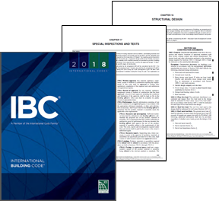
How Accreditation Can Lead to Smarter Cities
Building Codes require Code Officials to approve fabricators as well as agencies engaged in conducting tests or furnishing inspection services
Many departments may lack the resources to review and approve fabricators, inspection agencies, etc.
Specialized accreditation agencies like IAS provide specific accreditation programs based on code requirements
Regulators can turn to accreditation listings which are freely available for reference

Slide 10
Specialty Accreditation Programs for Regulators
In order for Code Officials to have confied, advanced building codes often require Code Officials to Approve Fabricators and Inspection Agencies through
Review of the Management System
Periodic Audits of the Organization
The challenge:
Many departments lack the resources to review and audit organizations

Slide 11
Specialty Accreditation Programs for Regulators
The solution… Specialty Accreditation:
For example…IAS provides Code Enforcement support to Building Officials by accrediting the Management System and Inspection Practices of Fabricators:
IAS provides verification that accredited fabricators of structural steel (AC172), reinforced and precast/pre-stressed concrete (AC157) and wood wall panels (AC196) meet the requirements in Chapter 17 of the International Building Code® and IAS accreditation criteria.
Getting accredited for the above fabricator programs involves
Assessing the fabricator’s management system
Verifying that on-site inspections meet industry standards and IAS accreditation criteria.
Ongoing periodic assessments as required by the Building Code.
Notes:
Applies to manufacturers outside the US – most building regulators in the US understand the value of a quality management system accreditation – Philippines, South Korea, China are using for this purpose
***discuss overview of Chapter 17
Incorporates key components from ISO/IEC with modifications based on special characteristics of each accreditation process. The accreditation criteria developed by IAS is developed by a technical committee and approved by a technical review committee. Latest AC took 18 months to develop.
Advantage to jurisdictions in India is to have

Slide 12
Specialty Accreditation Programs for Regulators
IAS also provides Code Enforcement support to Building Officials by accrediting the Management System and Inspection Practices of Special Inspection Agencies:
IAS provides verification that accredited Special Inspection Agencies (AC291) performing certain specialized inspections prescribed in the construction code meet the requirements in Chapter 17 of the International Building Code® and IAS accreditation criteria.
Getting accredited for special inspection involves
Assessing the agency’s management system
Verifying that practices meet industry standards and IAS accreditation criteria.
Ongoing periodic assessments as required by the accreditation standard
Notes:
code identifies special inspection agencies – for projects – used frequently when jurisdictions are seeing underperformance in their third party inspectors - need to verify that their inspectors are performing to a higher standard, both technical and soft skills (behavior)

Slide 13
Specialty Accreditation Programs for Regulators
IAS provides Code Enforcement support to Building Officials by accrediting the Inspection Programs of Companies that Design and Fabricate Custom-Engineered Metal Building Systems
IAS provides verification that accredited Metal Building System Fabricators (AC472) meet the requirements of the International Building Code®, accreditation criteria and related standards.
Getting accredited as a Metal Building System Fabricator involves:
Assessing essential inspection programs related to designing, specifying, building and/or approving metal building systems.
Ongoing periodic assessment as required by the accreditation standard and the International Building Code
Notes:
Membership organizations in that encourage their members to achieve accreditation to achieve higher market share – Metal Building Manufacturers Association - 2 story and under commercial buildings – requires all of their members to be accredited to AC472

Slide 14
Specialty Accreditation Programs for Regulators
IAS provides Code Enforcement support to Building Officials by accrediting the Inspection Programs of Manufacturers of Cold-formed Steel
IAS provides verification that accredited Cold-formed Steel Manufacturers (AC473) who produce cold-formed purlins, Z- or C-shaped steel structural members or roll-formed sheeting meet the requirements of the accreditation criteria and related.
Getting accredited as a Cold-formed Steel Manufacture involves:
Assessing inspection programs essential to cold-formed steel manufacturing
Verifying personnel, organization, experience, knowledge, management system, and commitment essential to operate in accordance with specified requirements
Ongoing periodic assessment as requirement by the accreditation standard
Notes:
Ancillary members for building structures – not for structural components

Slide 15
Specialty Accreditation Programs for Regulators
IAS provides Code Enforcement support to Building Officials by accrediting the Inspection Programs of Companies that Assemble Metal Building Systems
IAS provides verification that accredited Metal Building System Assemblers (AC478) meet the requirements of the International Building Code®, accreditation criteria and related standards.
Getting accredited as a Metal Building Assembler involves:
Assessing the company’s management system, assembly processes, internal safety, training programs, periodic jobsite inspections and more
Ongoing periodic assessment as requirement by the accreditation standard
Notes:
Extends quality system to assemblers of components covered by AC472 – on-site erection of the building

Slide 16
Specialty Accreditation Programs for Regulators
IAS provides Code Enforcement support to Building Officials by accrediting the Permitting, Plan Review and Inspection Practices of Regulatory Bodies and BSSPs
IAS provides verification that accredited Building Departments and Building Safety Service Providers (BSSPs) (AC251) and Fire Prevention Departments (AC426) meet the requirements of the International Building/Fire Code®, accreditation criteria and related standards.
Getting accredited as a Regulatory Body involves:
Assessing the plan review, permitting, and inspections activity and quality management system
Verifying adequate personnel, expertise, training, etc.
Ongoing periodic assessments as required by the criteria
Notes:
Could be used to help a new building department to determine how the department should be structured – build infrastructure around it

Slide 17
Additional Accreditation Information
Accreditation programs can be developed to address any challenge faced by building safety professionals
Prerequisite: must be driven by a need to improve safety and quality in construction (not just financially driven)
No cost to requestor to develop new criteria as long as prerequisite is satisfied
For additional information, please visit www.iasonline.org or contact:
Ms. Sandi McCracken
IAS Director of Construction & Industrial Relations
smccracken@iasonline.org
Ms. Kellee Fernandez
IAS Accreditation Officer—Regulatory Programs
kfernandez@iasonline.org

Slide 18
ICC Evaluation Service:
A Subsidiary of the International Code Council
Accredited by ANSI, the Standards Council of Canada (SCC) and EMA in Mexico to ISO/IEC 17065
Staffed by licensed professional engineers in a variety of disciplines (Structural, Mechanical, Civil, etc.) who evaluate building products for compliance with building codes and standards
Special expertise in developing and interpreting ICC-ES Acceptance Criteria (ACs) for innovative products
Notes:
-ICC-ES continues to develop and use acceptance criteria for innovative products that are not necessarily mentioned in the code. Such products fall into many categories such as concrete, masonry, metals, wood, plastic, thermal and moisture control, doors and windows, vents, plumbing as well as HVAC.
ICC-ES conducts product evaluation to state codes such as Florida and California, and City Codes such as the Los Angeles Building and Residential Code.

Slide 19
What is a Product Certification?
Review of products against a standard, a criteria, or a code to ensure continuous compliance of products
Certification steps include:
review of products
periodic inspection of plants (by an ISO/IEC 17020 accredited inspection agency)
periodic review of submitted information against new or revised standards
Notes:
-Inspection of the manufacturing plants is one of the most important parts of product certification. It allows ICC-ES to ensure that the product that was once evaluated by ICC-ES and deemed as compliant, continues to comply with the requirements of codes and application criteria or standards. This is why code officials approve products based upon ICC-ES evaluation reports and listing with confidence. They sleep well at nights knowing that a high level of rigor has gone into the evaluation and continuous compliance of the product.

Slide 20
Product Certification Programs for Building Products
Product Listing to a Standard
Product Evaluation for innovative products to specially-developed Evaluation Criteria
Other Product Certifications:
Solar Thermal Ratings and Listings
Plumbing, Mechanical and Gas (PMG) Listings
Environmental verification/certification specific sustainability (green) targets
Notes:
Product listing is a new service recently established by ICC-ES to give its clients a choice from the existing service providers. The product listing is conducted to the standards with the I codes as well and the National Building Code of Canada. Example of products that can be listed are: acoustic insulations, aluminum composite materials, canopy materials, duct insulation, foam plastics, Interior finishes, interior wall and ceiling materials, roof papers, and sidings.
-The solar thermal ratings and listing is offered by Solar Rating Certification Corporation which is a new division of ICC-ES. Such products are listed and rated using the SRCC standards.
-The plumbing, mechanical, and fuel gas division of ICC-ES conducts product certification to the I-Codes, U-Codes as well and National Plumbing Code of Canada and the standards within those codes. As previously mentioned, ICC-ES PMG is also capable of conducting product certification to the Mexican NOMs in Mexico (NOM stands for Norms of Mexico). The PMG program conducts product certification to all available EPA WaterSense specifications. There is a separate directory available on line for such listings. Plumbing products evaluated by ICC-ES range from toilets and faucets to pipes and backflow preventers to swimming pools to toxicity evaluation, etc.
The environmental program conducts a variety of activities:
-product evaluation to EPA EnergyStar specifications in the area of roofing and seal and insulate
-Issuing Variable Attribute Reports (VAR) to the Environmental Criteria published by ICC-ES.
-Conducting activities which result in the publication of Environmental Product Declarations (EPD). The EPDs are evaluated to Product Category Rules (PCR). PCRs and the criteria use to publish EPDs.

Slide 21
Innovative Products Drive Smart Cities
New technologies are being introduced at a pace that exceeds the process for adopting and implementing new Building Codes and Standards
Smart City stakeholders want and need to utilize innovative products
The challenge:
Building departments often lack the tools and resources to ensure the safety and conformity of the innovative products that Smart Cities need

Slide 22
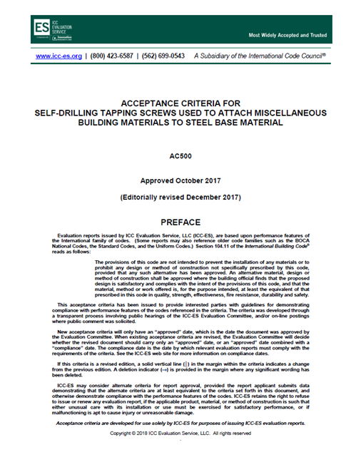
Conformity Assessment for Innovative Products
The solution… Acceptance Criteria:
Document developed by an accredited third party Conformity Assessment Body staffed by technical experts
in consultation with the manufacturer
with input from interested parties
Designed to address products or applications not defined or contained in existing codes and standards
Vetted in a public input process and approved by an independent Evaluation Panel comprised of code officials
Notes:
-It is important to add that ICC-ES acceptance criteria are for use by ICC-ES only.
-ICC-ES is the only entity accredited to evaluated products to ICC-ES acceptance Criteria.
-ICC-ES is the only entity that can provide proof of compliance to ICC-ES acceptance criteria.

Slide 23
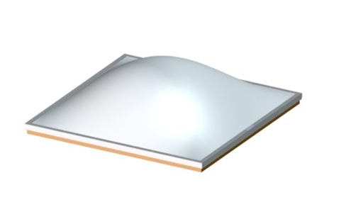
Conformity Assessment for Innovative Products
Acceptance Criteria Examples
Plastic Glazed Skylights
(AC16)
Exterior Continuous Thermal
Insulation Systems (ECTIS)
(AC397)
PV Array Roof Attachment Systems
(AC467)

Slide 24
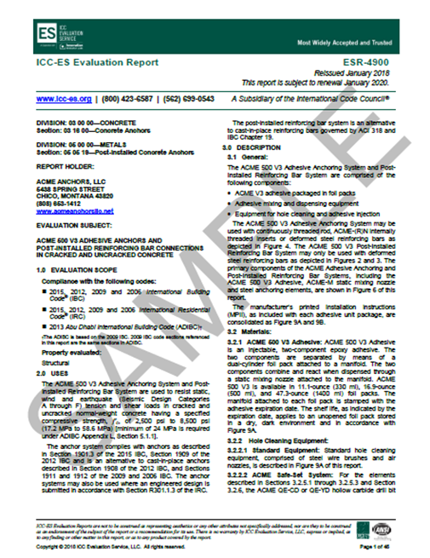
Conformity Assessment for Innovative Products
Evaluation Reports are issued by accredited third party Conformity Assessment Bodies with relevant scope of accreditation to confirm the compliance of an innovative product to:
Code Provisions – the Building Code is the basis for evaluation
Acceptance Criteria – for innovative products not specifically referenced in the Building Code, existing or new Acceptance Criteria can be used as the basis for evaluation

Slide 25
Conformity Assessment for Innovative Products
What is an Evaluation Report?
“document that…presents the findings, conclusions and recommendations from a particular evaluation” (CDC, Developing an Effective Evaluation Report guidelines)
demonstrates that new and innovative building products comply with code requirements
provides information about what code requirements or acceptance criteria were used to evaluate the product, how the product should be installed, how to identify the product, and much more
Notes:
-The evaluation report is the document that encapsulates the products evaluation.
-It references the report number on the upper right hand corner. That number is unique to that report.
-It references the Construction Specifications institute number(s) on the top left hand corner. This is a widely used indexing system to organize construction data.
-The product and the scope of evaluation is normally on the first page.
-The uses and the description of the product normally starts on the first page.
-The condition of use, evidence submitted including the AC it was evaluated to is normally toward the end.
The product identification requirement is normally at the end as well.

Slide 26
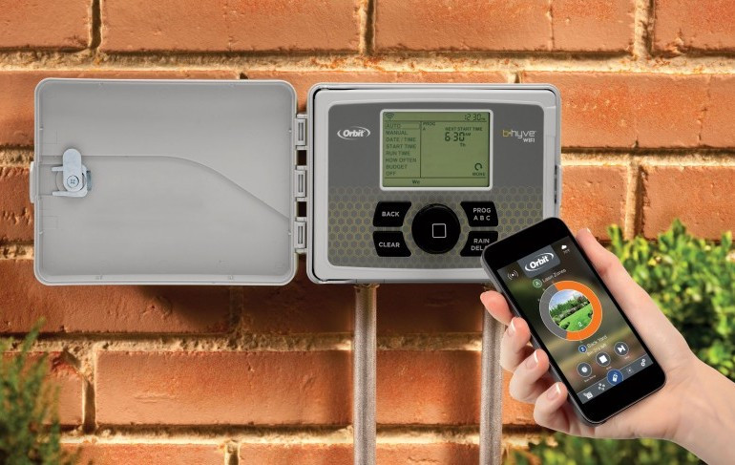
Conformity Assessment for Innovative Products
Evaluation Report Examples
Quick Mount PV Roof Mounts
(ESR-3744)
Orbit Weather-Based
Irrigation Controller
(PMG-1380)
Tesla Solar Roof
(ESR-4074)

Slide 27
Conformity Assessment for Innovative Products
ISO/IEC 17065 Product Evaluation Process
Initial contact and estimation of capabilities and cost
Manufacturer submits an application along with supporting documentation
Products tested at an accredited testing laboratory
Initial inspection of manufacturing process
Successful evaluation and issuance of an evaluation report
Continuous Compliance: Inspections to verify products are manufactured consistent with originally certified product
Notes:
-Inspection of the manufacturing plants is one of the most important parts of product certification. It allows ICC-ES to ensure that the product that was once evaluated by ICC-ES and deemed as compliant, continues to comply with the requirements of codes and application criteria or standards. This is why code officials approve products based upon ICC-ES evaluation reports and listing with confidence. They sleep well at nights knowing that a high level of rigor has gone into the evaluation and continuous compliance of the product.

Slide 28
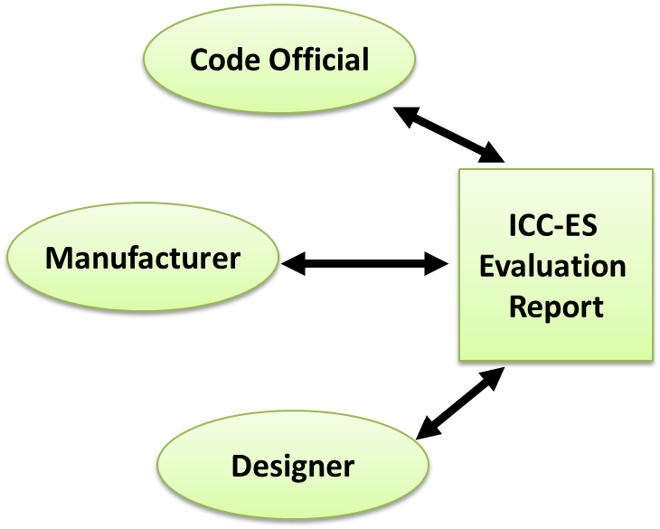
Benefits of Product Evaluation
Code Officials
Time & resource savings
Rigor of evaluation process
Manufacturer
Evidence of compliance with codes and standards
Reduces regulatory barriers
Allows new innovative products to be used in construction projects
Competitive advantage
Designers – ease of finding approved products to specify
Notes:
Code officials, manufacturers and designers and specifiers all benefit differently form ICC-ES Evaluation reports.
-Code officials benefit because they do not have time or resources to evaluate products themselves. Moreover, they trust ICC-ES reports because of the high level of rigor ICC-ES puts into product evaluation.
-Designers, engineers and architects enjoy the ICC-ES reports because they don’t have to look no further in order to specify products.

Slide 29
Additional Product Certification Information
For additional information, or to view all ICC-ES evaluation reports and product listings, please visit www.icc-es.org or contact:
Mr. Shahin Moinian, P.E.
President, ICC Evaluation Service
smoinian@icc-es.org
Mr. William Gould, P.E.
Senior Vice President of Evaluation & Technical Services
wgould@icc-es.org

Slide 30
Thank you!
Project owners, specification writers, and building jurisdictions rely upon ICC and its subsidiary organizations to support their challenges in the world of buildings.
For additional information, please visit www.iccsafe.org or contact:
Judy Zakreski
ICC Vice President of Global Services
jzakreski@iccsafe.org
+1.202.730.3978

